Slide 1

IDENTIFICATION OF FAKE INDIAN CURRENCY USING CONVOLUTIONAL NEURAL NETWORK
1.KALANJERI BHUVANESWARI (219E1A0589) 2.JOGIREDDYGARI SAI BHAVANA (219E1A0584)
3.JERRI RAJESH (219E1A0583) 4.KALUVA ABDULLA (219E1A0595 ) BATCH NO : 02 UNDER THE ESTEEMED GUIDANCE OF Dr. A. SARITHA
DEPARTMENT OF COMPUTER SCIENCE AND ENGINEERING SRI VENKATESWARA ENGINEERING COLLEGE Karakambadi Road , Opp. LIC Training Center, Tirupati-517507

Slide 2
IDENTIFICATION OF FAKE INDIAN CURRENCY USING CONVOLUTIONAL NEURAL NETWORK

Slide 3
INDEX
Abstract
Introduction
Literature survey
Existing Method
Disadvantages
Proposed method
Advantages

Slide 4
Project Flow
Modules
UMLS
Output screens
Conclusion
Future enhancement
References

Slide 5
ABSTRACT
The spread of counterfeit currency is a major threat to economic stability, requiring advanced methods for accurate detection. This project, titled "Identification of Fake Indian Currency Using Convolutional Neural Networks," introduces a new approach to detecting fake currency using deep learning techniques. It focuses on three main models: Mobile Net , Res Net, and a hybrid model that combines Mobile Net with Support Vector Machines (SVM). Another version of the hybrid model combines Mobile Net with both SVM and Random Forest. These models are evaluated based on how accurate, precise, reliable, and robust they are in real-world situations.

Slide 6
OBJECTIVE OF PROJECT
The objective of this project is to develop a sophisticated counterfeit detection system for Indian currency using advanced Convolutional Neural Networks (CNNs). By employing models such as MobileNet, and integrating hybrid approaches combining CNNs with Support Vector Machines (SVM) and Random Forest, the project aims to enhance the accuracy and efficiency of counterfeit detection. The system will be designed to automatically and reliably distinguish between genuine and fake notes, minimizing human error and improving overall security. The ultimate goal is to provide a scalable, high-performance solution that strengthens the financial system's resilience against currency fraud.

Slide 7
PROBLEM STATEMENT
Counterfeit currency poses a significant challenge to financial systems, leading to economic losses and undermining trust in the currency. Current detection methods often rely on manual inspection or basic machine learning techniques, which may lack precision and efficiency. This project addresses the problem of detecting fake Indian currency by leveraging advanced Convolutional Neural Networks (CNNs) such as MobileNet. It also explores hybrid approaches combining CNNs with Support Vector Machines (SVM) and Random Forest to improve accuracy and reliability. The goal is to develop a robust, automated system capable of distinguishing between genuine and counterfeit notes with high precision.

Slide 8
INTRODUCTION
Traditional methods of counterfeit detection, often reliant on manual inspection and basic verification tools, are becoming inadequate in the face of advanced counterfeiting techniques. The introduction of CNN models such as Mobile Net and offers a promising approach to enhancing counterfeit detection systems. Additionally, hybrid models combining CNNs with Support Vector Machines (SVM) and Random Forest aim to capitalize on the strengths of ensemble learning techniques.
This project will develop a robust, automated system capable of accurately distinguishing between genuine and counterfeit Indian currency. By improving detection accuracy and efficiency, the proposed system has the potential to significantly strengthen financial security measures, providing a crucial tool for safeguarding against currency fraud.

Slide 9
LITERATURE SURVEY
S.NO | YEAR | AUTHORS | TITLE | OUT COMES
1 | 2017 | Howard, A. G., et al. | MobileNets: Efficient Convolutional Neural Networks for Mobile Vision Applications | Introduced MobileNet, a lightweight and efficient CNN for mobile and embedded vision applications.
2 | 2018 | Zhang, X., Zhou, X., Lin, M., & Sun, J. | ShuffleNet: An Extremely Efficient Convolutional Neural Network for Mobile Devices | Proposed ShuffleNet, an efficient CNN architecture optimized for mobile devices.

Slide 10
S.NO | YEAR | AUTHORS | TITLE | OUT COMES
3 | 2016 | He, K., Zhang, X., Ren, S., & Sun, J. | Deep Residual Learning for Image Recognition | Introduced ResNet, a deep learning architecture with residual connections improving training depth.
4 | 2019 | Tan, M., & Le, Q. V. | EfficientNet : Rethinking Model Scaling for Convolutional Neural Networks | Presented EfficientNet, a family of models scaling up convolutional neural networks efficiently.

Slide 11
EXISTING SYSTEM
Existing methods for counterfeit currency detection often rely on Convolutional Neural Networks (CNNs) due to their effectiveness in image classification tasks. CNN-based systems analyze currency images to identify features such as textures, patterns, and security marks. Common approaches use models like Le Net, Alex Net, or VGG for feature extraction and classification. These models are trained on large datasets of genuine and counterfeit notes to learn distinguishing characteristics. Despite their effectiveness, these methods may face limitations in handling variations in counterfeit quality and environmental conditions. Enhancing CNN models with advanced architectures and hybrid techniques can improve detection accuracy and reliability.

Slide 12
DRAWBACKS
1. Computational Complexity: Deep CNN models can be resource-intensive, requiring substantial computational power and memory, which may be challenging for real-time applications.
2. Sensitivity to Variations: CNNs might struggle with variations in counterfeit quality, image resolution, and environmental conditions, potentially leading to false positives or negatives.
3. Data Requirements: Training effective CNN models requires large datasets of high-quality images, including diverse examples of both genuine and counterfeit notes, which may not always be available.
4. Overfitting: Deep models can overfit to training data if not properly regularized, affecting their performance on unseen counterfeit types.

Slide 13
PROPOSED SYSTEM
The proposed system enhances counterfeit currency detection by integrating advanced Convolutional Neural Networks (CNNs) with hybrid machine learning models. It utilizes Mobile Net for their efficient and accurate image classification capabilities, combined with Support Vector Machines (SVM) and Random Forest to leverage ensemble learning techniques. This hybrid approach aims to improve detection precision and robustness by combining the strengths of each model. The system will process currency images to identify subtle counterfeit features, offering a scalable and real-time solution. By addressing the limitations of existing methods, this system seeks to provide a more reliable and efficient tool for safeguarding against counterfeit currency.

Slide 14
ADVANTAGES
1. Enhanced Accuracy: By combining CNNs like Mobile Net with SVM and Random Forest, the system leverages multiple models' strengths to improve detection accuracy and reduce false positives and negatives.
2. Efficient Processing: Mobile Net’s lightweight architecture ensures efficient performance on resource-constrained devices, making the system suitable for real-time applications.
3. Robustness: The hybrid approach enhances robustness against variations in counterfeit quality, image resolution, and environmental conditions, leading to more reliable detection.
4. Scalability: The system can be scaled to handle large volumes of currency images, making it suitable for various applications, from banknote validation to large-scale financial institutions.

Slide 15
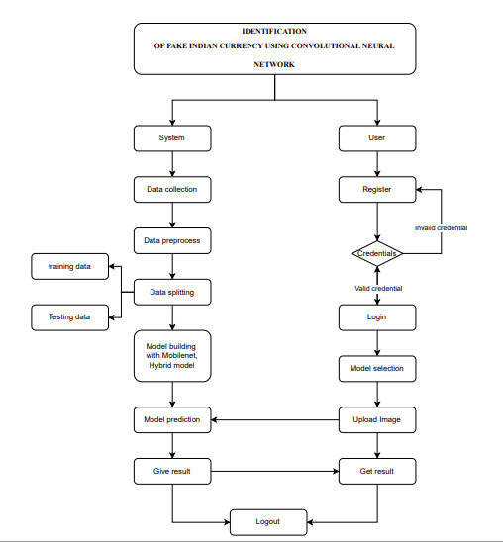
PROJECT FLOW DIAGRAM

Slide 16
HARDWARE & SOFTWARE REQUIREMENTS
HARDWARE REQUIREMENTS
Processor - I3/Intel Processor
RAM - 8GB (min)
Hard Disk - 128 GB
Key Board - Standard Windows Keyboard
Mouse - Two or Three Button Mouse
Monitor - Any

Slide 17
SOFTWARE REQUIREMENTS
Operating System : Windows 7/8/10
Server side Script : HTML, CSS, Bootstrap & JS
Programming Language : Python
Libraries : Flask, Torch, Tensorflow, Pandas
IDE/Workbench : VSCode
Server Deployment : Xampp Server
Database : MySQL

Slide 18
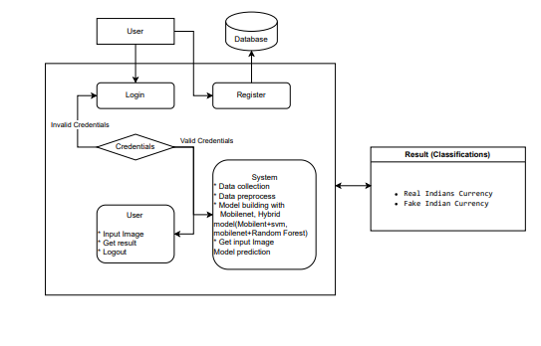
ARCHITECHTURE DIAGRAM

Slide 19
MODULES
1. System:
1.1 Data Collection: This module involves gathering a comprehensive dataset of currency images, including both genuine and counterfeit notes. The dataset is divided into training and testing subsets, typically with an 80% to 20% split.
1.2 Data Preprocessing: This step includes image resizing, normalization, and augmentation to enhance the quality and variability of the dataset. The preprocessed images are then ready for model training and testing.
1.3 Model Training: The CNN models (MobileNet) are trained using 80% of the dataset. This involves fine-tuning model parameters and optimizing performance to accurately classify currency images.
1.4 Hybrid Model Integration: Combining CNNs with Support Vector Machines (SVM) and Random Forest to create a hybrid model. This module focuses on integrating these models and tuning their combined performance.

Slide 20
1.5 Model Testing: The remaining 20% of the dataset is used to evaluate the performance of the trained models. Metrics such as accuracy, precision, and recall are computed to assess model effectiveness.
1.6 Model Saving: Once trained, the models (including the hybrid model) are saved in a format such as .h5 or .pkl to preserve their learned parameters and weights.
1.7 Model Prediction: New currency images are input into the trained models to predict whether they are genuine or counterfeit. This module handles the prediction process and outputs results.

Slide 21
2. User:
2.1 Register: Users register an account in the system with their credentials to gain access.
2.2 Login: Users log in with their registered credentials to access the currency detection features.
2.3 Upload Data: Users can upload currency images for detection. These images are processed by the model for analysis.
2.4 View Results: Users receive and view predictions from the model, which indicates whether the uploaded currency is genuine or counterfeit.
2.5 Logout: Users can log out of the system to ensure their session and personal data are secure.

Slide 22
METHODOLOGY
Mobile Net:
To detect fake Indian currency using MobileNet, first, a large collection of real and fake currency images is gathered. These images are resized to 224x224 pixels, and some changes like rotating and flipping are applied to help the model learn better.
The dataset is then divided into three parts:
1. Training set – to teach the model
2. Validation set – to check the model’s accuracy during training
3. Test set – to see how well the model works on new images

Slide 23
The MobileNet model is trained to recognize fake and real notes, and its accuracy is checked using precision, recall, and F1-score. Adjustments are made if needed to improve accuracy.
Once training is complete, the model is used in a real-time fake currency detection system. It is optimized to work quickly and efficiently on different devices.
MobileNet is chosen because it is fast and lightweight. A version of MobileNet already trained on a large image dataset (ImageNet) is used, and only the last layer is changed to detect real vs. fake notes.
The earlier layers remain unchanged to keep the useful features they already learned. The final layers are trained slowly and carefully to adapt to currency detection.

Slide 24
MobileNet + SVM Hybrid Model :
A MobileNet and SVM hybrid model is used to detect fake Indian currency. First, a dataset of real and fake notes is collected and processed by resizing, normalizing, and augmenting images. MobileNet extracts important features from these images, and an SVM classifier uses these features to classify them as real or fake. The SVM model helps improve accuracy by defining clear decision boundaries.

Slide 25
MobileNet + Random Forest Hybrid Model
To detect fake currency, we use a combination of MobileNet (a deep learning model) and Random Forest (a machine learning algorithm).
How It Works:
Collect & Prepare Data:
Gather images of both real and fake Indian currency notes.
Resize them to 224x224 pixels (so they fit MobileNet).
Normalize and enhance them using techniques like rotation and flipping.
Feature Extraction with MobileNet:
MobileNet is a lightweight deep learning model.
Instead of classifying directly, it extracts important features (patterns, colors, textures) from currency images.

Slide 26
Classification with Random Forest:
These extracted features are given to Random Forest.
Random Forest is an algorithm that makes decisions using multiple decision trees.
It learns from the extracted features and classifies notes as real or fake.
Training & Testing:
The dataset is split into training, validation, and test sets.
The model is fine-tuned using accuracy, precision, recall, and F1-score.
Deployment & Real-Time Detection:
Once trained, the model is used in a real-time detection system.
The system is optimized for fast and accurate counterfeit detection.
Continuous testing improves accuracy and reliability.
This hybrid approach ensures a highly accurate, efficient, and scalable solution
for detecting fake currency, enhancing financial security.

Slide 27
UML DIAGRAMS
1.Use Case Diagram:
A use case diagram in the Unified Modeling Language (UML) is a type of behavioral diagram defined by and created from a Use-case analysis. Its purpose is to present a graphical overview of the functionality provided by a system in terms of actors, their goals (represented as use cases), and any dependencies between those use cases. The main purpose of a use case diagram is to show what system functions are performed for which actor. Roles of the actors in the system can be depicted.

Slide 28
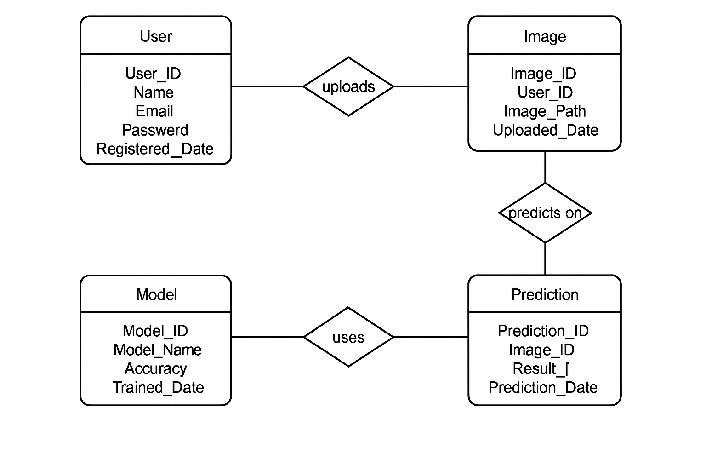
Fig: Use Case Diagram

Slide 29
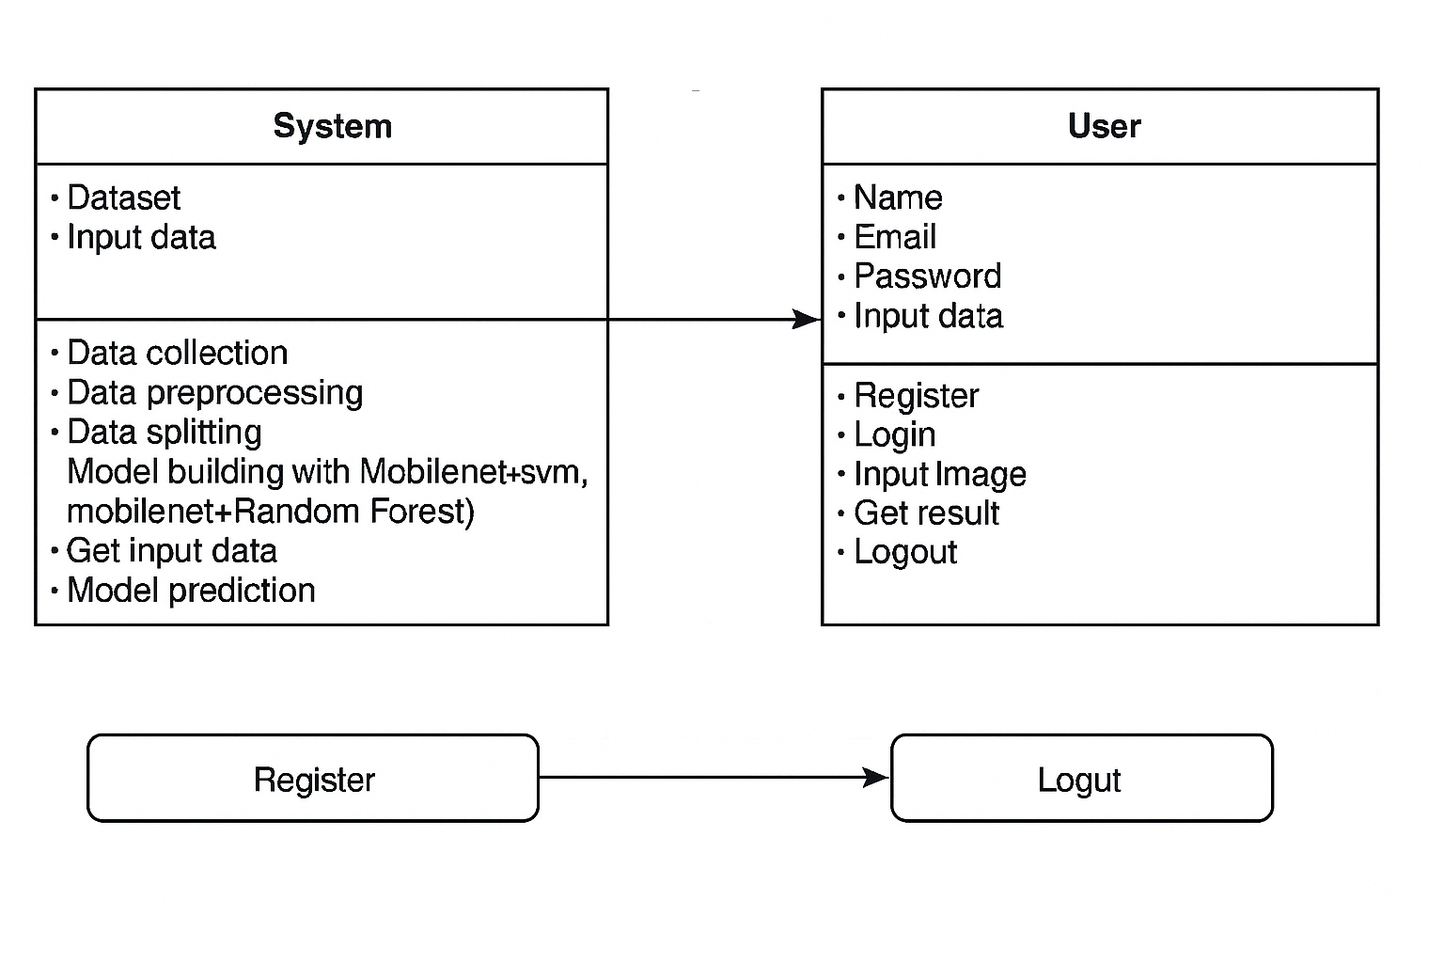
2.Class Diagram:
In software engineering, a class diagram in the Unified Modelling Language (UML) is a type of static structure diagram that describes the structure of a system by showing the system's classes, their attributes, operations (or methods), and the relationships among the classes. It explains which class contains information.

Slide 30
3.Sequence Diagram:
A sequence diagram in Unified Modelling Language (UML) is a kind of interaction diagram that shows how processes operate with one another and in what order. It is a construct of a Message Sequence Chart. Sequence diagrams are sometimes called event diagrams, event scenarios, and timing diagrams.

Slide 31
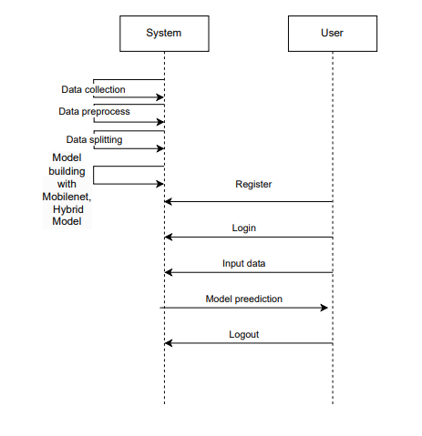
Fig: Sequence Diagram

Slide 32
4.Collaboration Diagram:
In collaboration diagram the method call sequence is indicated by some numbering technique as shown below. The number indicates how the methods are called one after another. We have taken the same order management system to describe the collaboration diagram. The method calls are similar to that of a sequence diagram. But the difference is that the sequence diagram does not describe the object organization whereas the collaboration diagram shows the object organization.

Slide 33
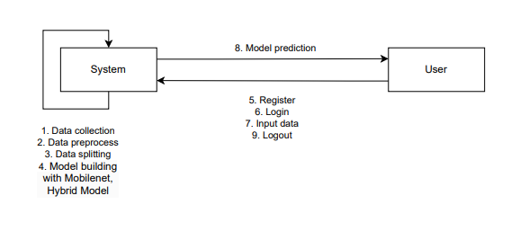
Fig: Collaboration Diagram

Slide 34
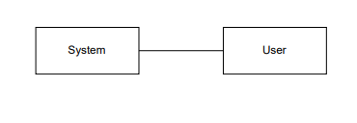
5.Deployment Diagram :
Deployment diagram represents the deployment view of a system. It is related to the component diagram. Because the components are deployed using the deployment diagrams. A deployment diagram consists of nodes. Nodes are nothing but physical hardware’s used to deploy the application.

Slide 35
6.Activity Diagram:
Activity diagrams are graphical representations of workflows of stepwise activities and actions with support for choice, iteration and concurrency. In the Unified Modelling Language, activity diagrams can be used to describe the business and operational step-by-step workflows of components in a system. An activity diagram shows the overall flow of control.

Slide 36
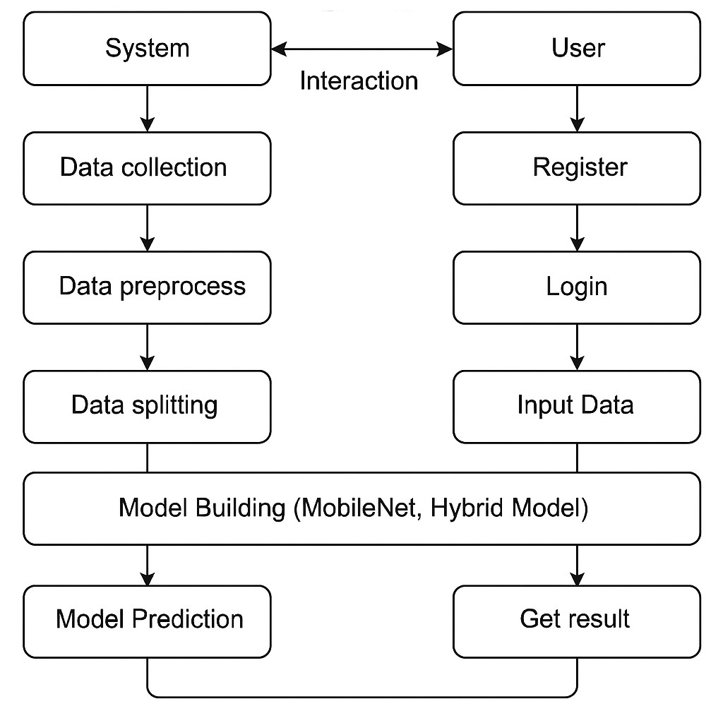
Fig: Activity Diagram

Slide 37
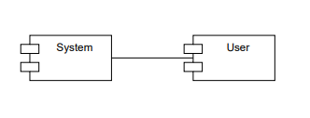
7.Component Diagram:
A component diagram, also known as a UML component diagram, describes the organization and wiring of the physical components in a system. Component diagrams are often drawn to help model implementation details and double-check that every aspect of the system's required functions is covered by planned development.

Slide 38

RESULTS AND SCREENSHOTS
1.HOME PAGE: This is the index Page of our website.

Slide 39
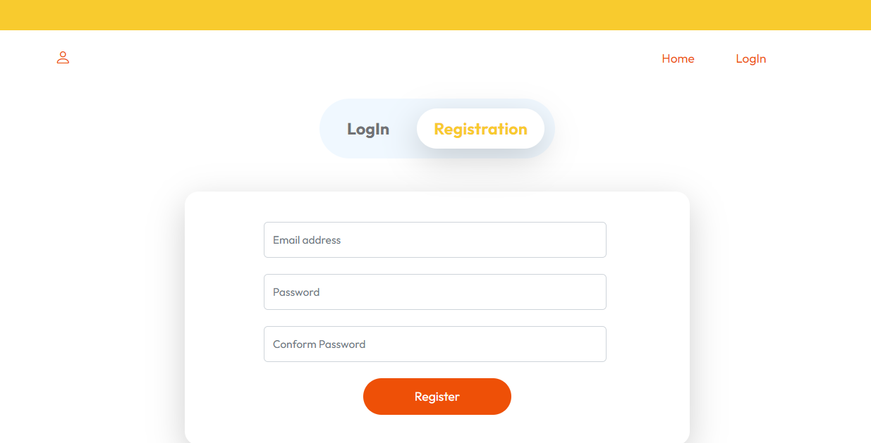
2.REGISTRATION PAGE: User can register with their credentials.

Slide 40
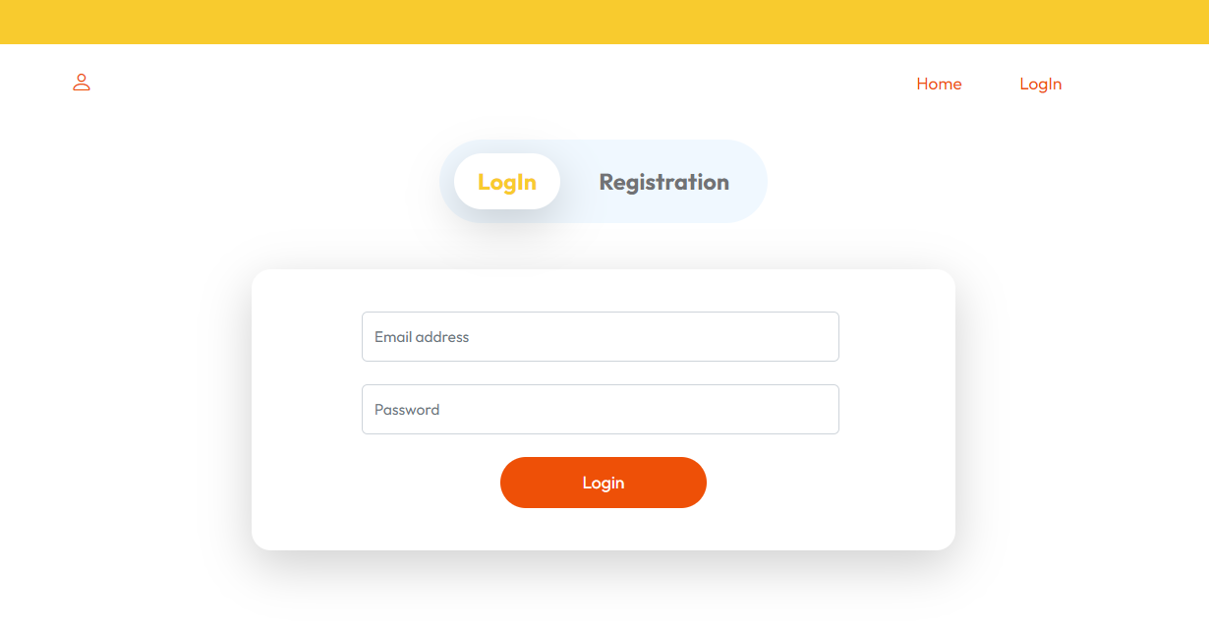
3.LOGIN PAGE: User can login with their registered credentials.

Slide 41
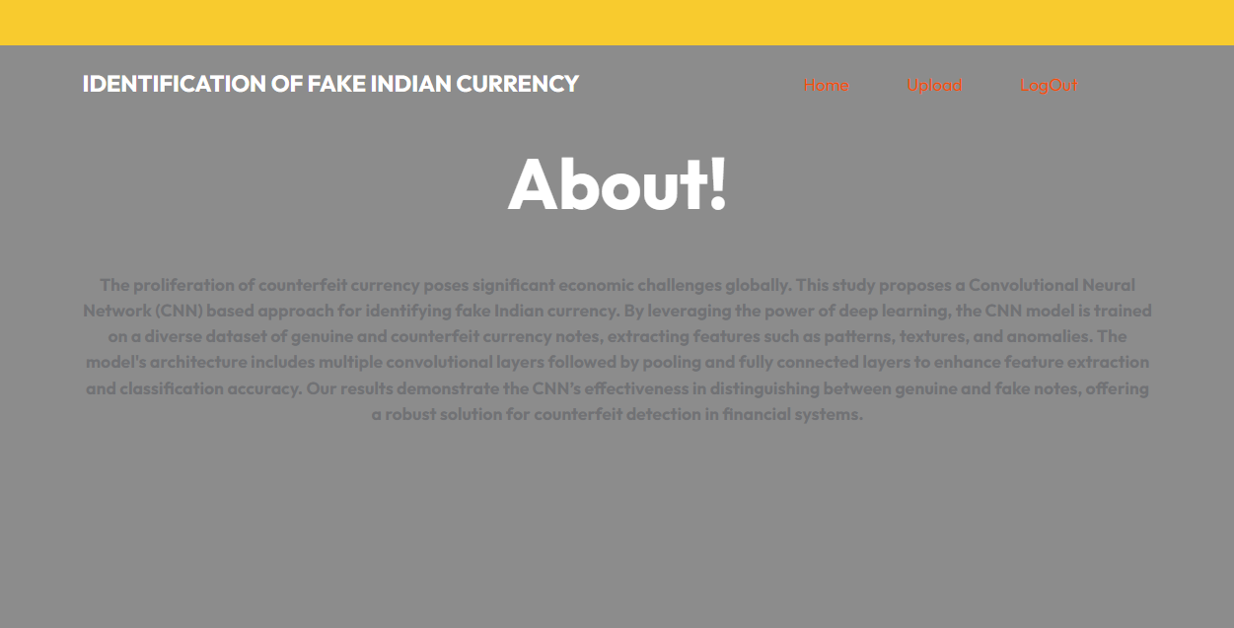
4.HOME PAGE: After user login this page will be come.

Slide 42
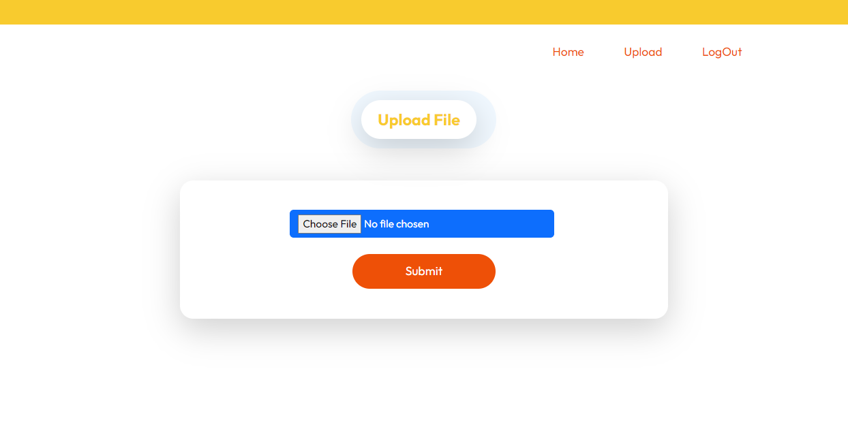
5.PREDICTION PAGE: In here user can upload image and get prediction.

Slide 43
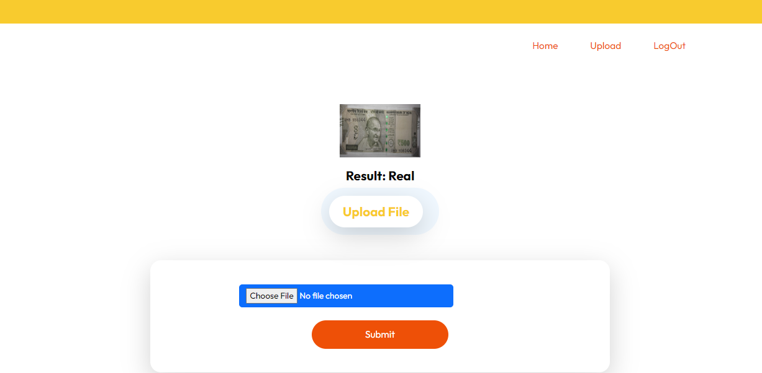
6.RESULT PAGE: In here, user result will be display.
Prediction - Real

Slide 44
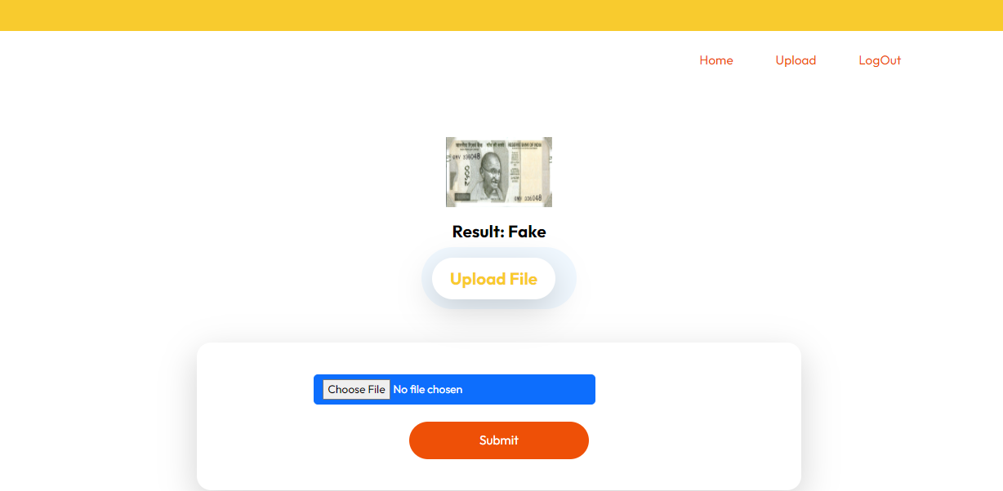
7.RESULT PAGE: In here, user result will be display.
Prediction - Fake

Slide 45
CONCLUSION
The study found that the MobileNet model is very good at detecting fake Indian currency, with 97% accuracy. It correctly identified real and fake notes most of the time, making very few mistakes.A hybrid model that combined MobileNet with Random Forest had a slightly lower accuracy of 94%. While it was excellent at detecting fake notes, it sometimes failed to recognize them correctly.Overall, MobileNet is the better choice for detecting fake currency because it is more accurate and reliable. In the future, researchers could improve these models or try new methods to make detection even better.

Slide 46
FUTURE ENHANCEMENT
To make fake Indian currency detection using Convolutional Neural Networks (CNNs) even better, we can plan a few improvements. First, we can use more advanced models like EfficientNet, which can understand images more deeply and accurately.
Using transfer learning—where we take models trained on large image datasets and adjust them for currency detection—can help, especially when we don’t have many training images.
Another good idea is to use ensemble learning, where we combine different models to make better predictions. For example, we can mix CNNs with other methods like support vector machines (SVM) or gradient boosting to get stronger results.
Improving the dataset is also very important. We can add more examples of fake notes with different lighting, angles, and background conditions. Using data augmentation—like rotating, zooming, or shifting images—can help the model learn better and become more flexible.

Slide 47
REFERENCES
Howard, A. G., Zhu, M., Chen, B., Kalenichenko, D., Wang, W., Weyand, T., ... & Adam, H. (2017). MobileNets: Efficient Convolutional Neural Networks for Mobile Vision Applications. arXiv preprint arXiv:1704.04861.
Zhang, X., Zhou, X., Lin, M., & Sun, J. (2018). ShuffleNet: An Extremely Efficient Convolutional Neural Network for Mobile Devices. In Proceedings of the IEEE conference on computer vision and pattern recognition (pp. 6848-6856).
He, K., Zhang, X., Ren, S., & Sun, J. (2016). Deep Residual Learning: for Image Recognition. In Proceedings of the IEEE conference on computer vision and pattern recognition (pp. 770-778).

Slide 48
THANK YOU!

